Slide 1
DSPG Internship program
and SDAD Organizational systems
Social and Decision Analytics Division (UVA-SDAD)

Slide 2
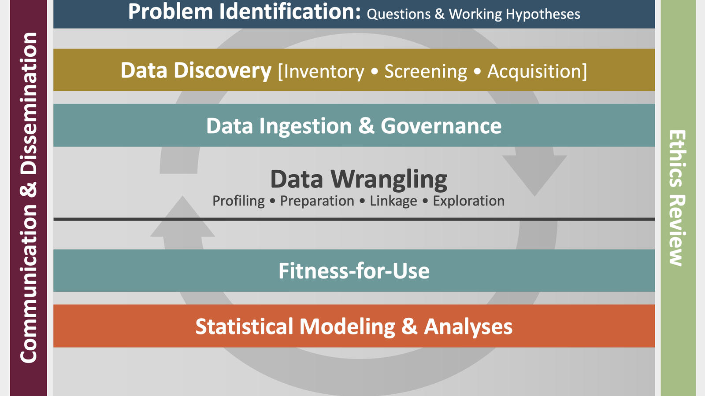
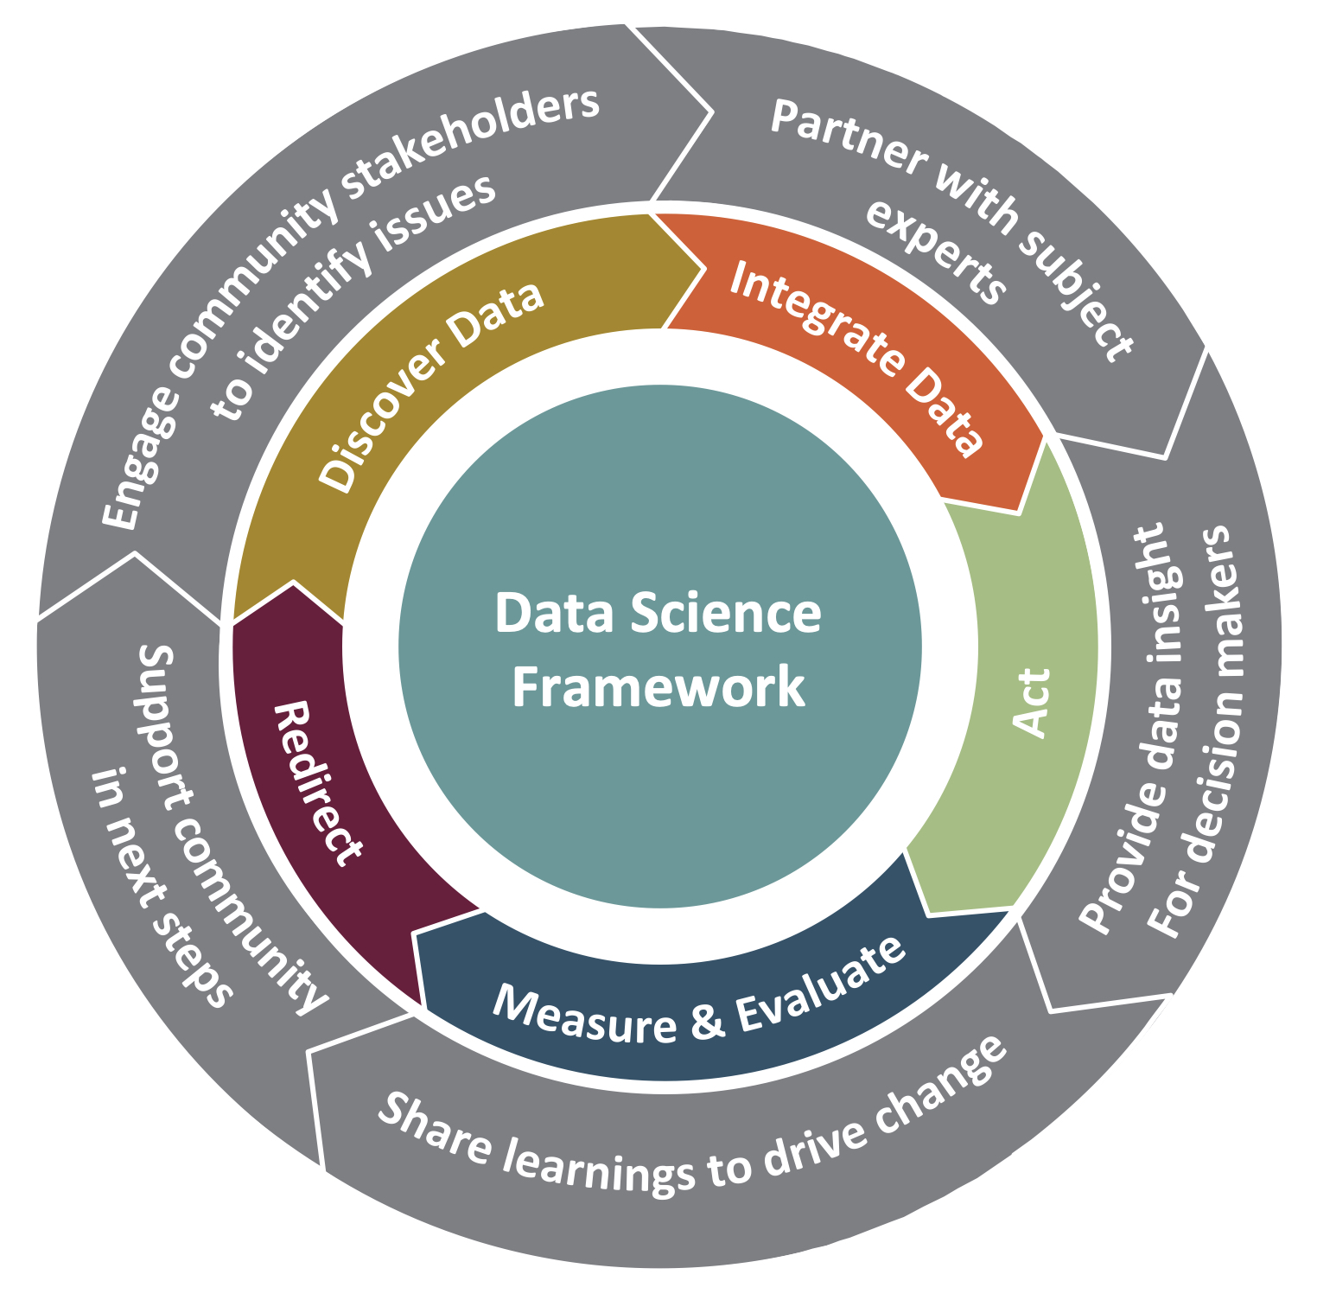
SDAD organizing principles

Slide 3
Meetings and such
Reoccurring meetings
Monday Check-in Meeting: 9:00 – 10:00 AM
Thursday lunch with Postdocs+™: 1:00 – 2:00 PM
Friday Wrap-up Meeting: 3:00 – 4:00 PM
Periodic meetings
Speaker series – approximately 2x month
Fri, June 24: Event in conjunction with Data Justice Academy
Tue, July 19, 12-1 pm: Tamara Kolda
Other days/times TBD
Other meetings & activities
IRB training: Wed, June 1 from 10:00 AM – 12:00 PM
Naming Things: Wed, June 1 from 1:00 – 2:00 PM
Qualitative analysis/Dedoose training: Mon, June 6 from 2:00 – 3:15 PM
GitHub: Mon, June 6 TBD

Slide 4
Operating norms and expectations
Working onsite
Weekly from 9:00 AM – 4:00 PM
Sign up with the BI onsite scheduler *
https://onsitehours.biocomplexity.virginia.edu/Appointment
Important for contact tracing
Sick? Running late? Emergencies?
Contact Kim, Joel, Stephanie, and (potentially) project lead
Communication protocol and scheduling
If there’s an action item (something you need to do), confirm receipt of message
Ask project leads about team norms re: communication and working style
Division has standard team operating procedures (WIP)
-----
* Not everyone may be entered in the system yet

Slide 5
Operating norms and expectations
Project assignment
You’ll be working on two projects and paired with someone on each*
Send Joel your top three preferences by Wed, June 1 at 1 PM
Include a note about technical skills: what you feel comfortable doing, what you want to learn
Once you have your projects, contact project leads to set up meeting and/or find out when the project team regularly meets
Mentors
Everyone will be assigned a mentor
Meet with them at least twice to talk about the program and future plans
Resource for questions or concerns throughout the summer
You can also ask Joel, Stephanie, Kim, and Jim (anyone in the office really)
-----
* The data commons projects will probably have three someones

Slide 6
Organizational infrastructure
Microsoft shop (for better or worse… mostly worse)
Microsoft suite: Outlook, Teams, SharePoint, OneDrive
Outlook calendar crucial for scheduling
We’ll also add you to SDAD Slack
Technical infrastructure will be covered by Postdocs+ ™ in just a few minutes
Rivanna (UVA’s High Performance Computer)
PGAdmin
GitHub
and much much more…?

